Slide 1
AN INTRODUCTION TO : VALUE SENSITIVE DESIGN
BY KOEN VAN TURNHOUT

Slide 2

WHO AM I
Koen van Turnhout
Professor of Human Experience and Media Design
Utrecht University of Applied Sciences
Background in:
Human Computer Interaction
Chair of Design Science Research Group & CHI Netherlands
Notes:
Image credit: HU Beelbank

Slide 3
03
Today:
1 A short history of Human-Cented Design
2 Value-sensitive Design Approaches
3 Values in data-driven systems

Slide 4
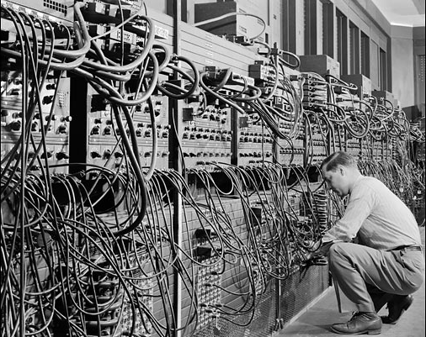
A Short HISTORY of HUMaN-Centred DesigN
“Human Factors” approach
50ies and 60ies
Mainframe computers
Dedicated design (hardware and software)
E.g. Airplane cockpits
“Humans” are describes in table books for design
Task-centred approach
Effectiveness is most important value
Eniac (1946)
Notes:
Image credit: https://sites.google.com/site/hongxacdthlt11/mo-dau-tim/phan-1/eniac-sage-neac

Slide 5
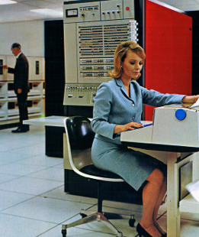
A Short HISTORY of HUMaN-Centred DesigN
Participatory Design Approach (Scandinavia)
70ies and beyond
Computers enter the workplace
Generic controls, dedicated software
E.g. Factories
“Humans” are considered design partners
Task-centred approach
Equality is most important value
IBM Mainframe (1964)
Notes:
Image credit: https://www.information-age.com/ibm-celebrates-50-years-its-landmark-mainframe-computer-123457881/

Slide 6
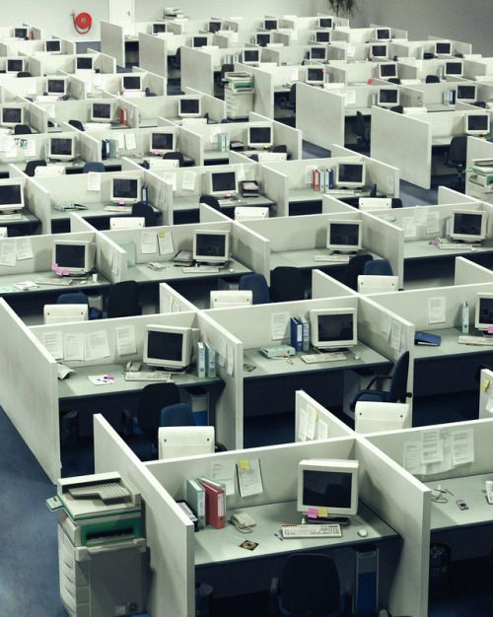
A Short HISTORY of HUMaN-Centred DesigN
User-centred Design (US)
80ies and 90ies.
Computers invade the workspace (and our homes).
Generic controls, generic software
E.g. Office Cubicles
“Humans” are considered object of design research
Needs-centred approach
Usability is most important value
Personal Computers (1980ies)
Notes:
Image credit:https://www.pinterest.at/pin/389491067777043082/

Slide 7
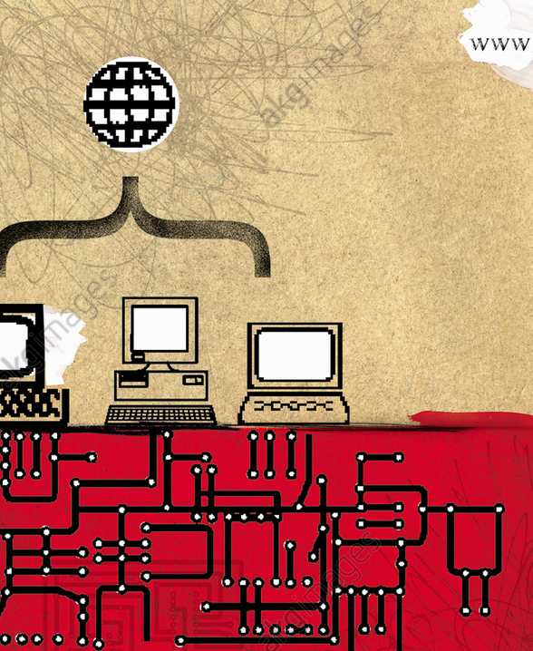
A Short HISTORY of HUMaN-Centred DesigN
Human-centred Design
90ies and 00s.
Networked computers, social software,generic controls, generic software
E.g. online computers
“Humans” are considered object of design research plus co-design
Needs-centred approach
Flexible (private) values
Networked Computer (1990ies)
ISO 9241-210:2019 Ergonomics of human-system interaction — Part 210: Human-centred design for interactive systems
https://www.iso.org/ru/standard/77520.html
Notes:
Image credithttps://www.akg-images.com/archive/-2UMEBMBA2O1_D.html

Slide 8
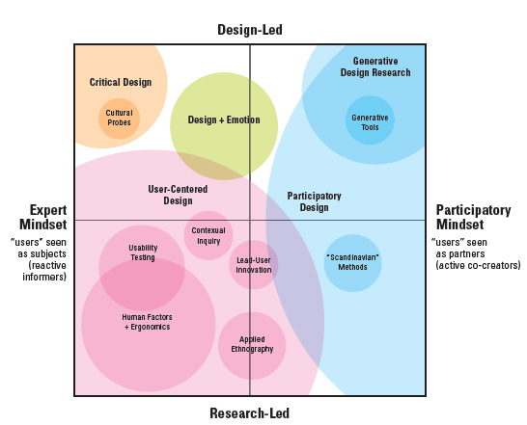
Sanders & Stappers, 2008
Expert mindset
“User as subject/informant”
Participatory mindset
“User as partner/creator”
Research-led
“Research drives design decisions”
Design-led
“Design drives research efforts”
Sanders, E. B. N., & Stappers, P. J. (2008). Co-creation and the new landscapes of design. Co-design, 4(1), 5-18.

Slide 9
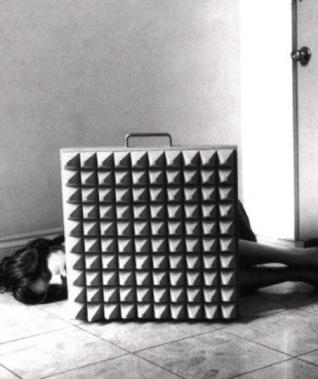
A Short HISTORY of HUMaN-Centred DesigN
Critical Design
00s- now.
Design as a way to challenge human values
E.g. Speculative Design, Design Fiction
“Humans” are antagonists in a drama about the status-quo in society.
Critical Approach
Questioning (public) values
Design Noir (2001)
Dunne, A., & Raby, F. (2001). Design noir: The secret life of electronic objects. Springer Science & Business Media.
Notes:
Image credit https://i1.wp.com/mariodcunha.com/wp-content/uploads/2018/02/PT_2740.jpg

Slide 10
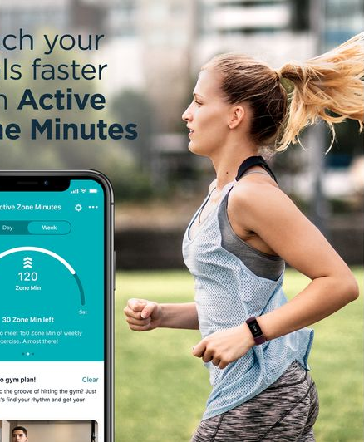
A Short HISTORY of HUMaN-Centred DesigN
Values in design
10s- now.
Mobile computers, Internet of Things
Specific design, generic software
“Humans” are but one of the stakeholders.
Worth-centred approach (beyond needs)
Private & public values
Fitbit (2010s)
Notes:
Image credithttps://www.akg-images.com/archive/-2UMEBMBA2O1_D.html

Slide 11
03
Today:
1 A short history of Human-Cented Design
2 Value-sensitive Design Approaches
3 Values in data-driven systems

Slide 12
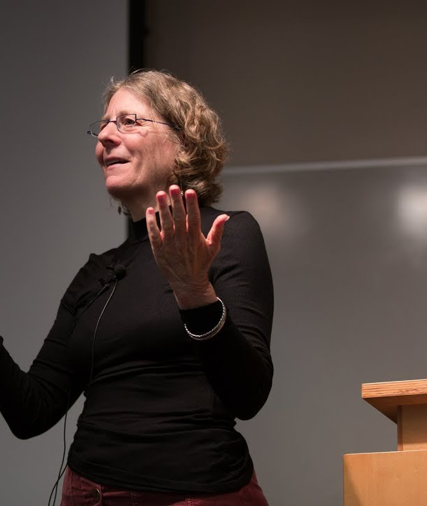
Value SENSTIVE DESIGN
Part of a family of ‘Value-focused approaches’
Worth-centred design (Cockton, 2005)
Value centred Participatory Design (Iversen et al. 2012)
Value sensitive Design (Friedman, 2003)
Adaptation of Human Centred-Design to include human values (meta-method).
Explicit attention to values of all stakeholders.
Explicit attention to non-human stakeholders.
Explicit attention to potential value conflicts.
Batya Friedman
Notes:
Image credit https://i.ytimg.com/vi/6HPgN050DIw/maxresdefault.jpg

Slide 13
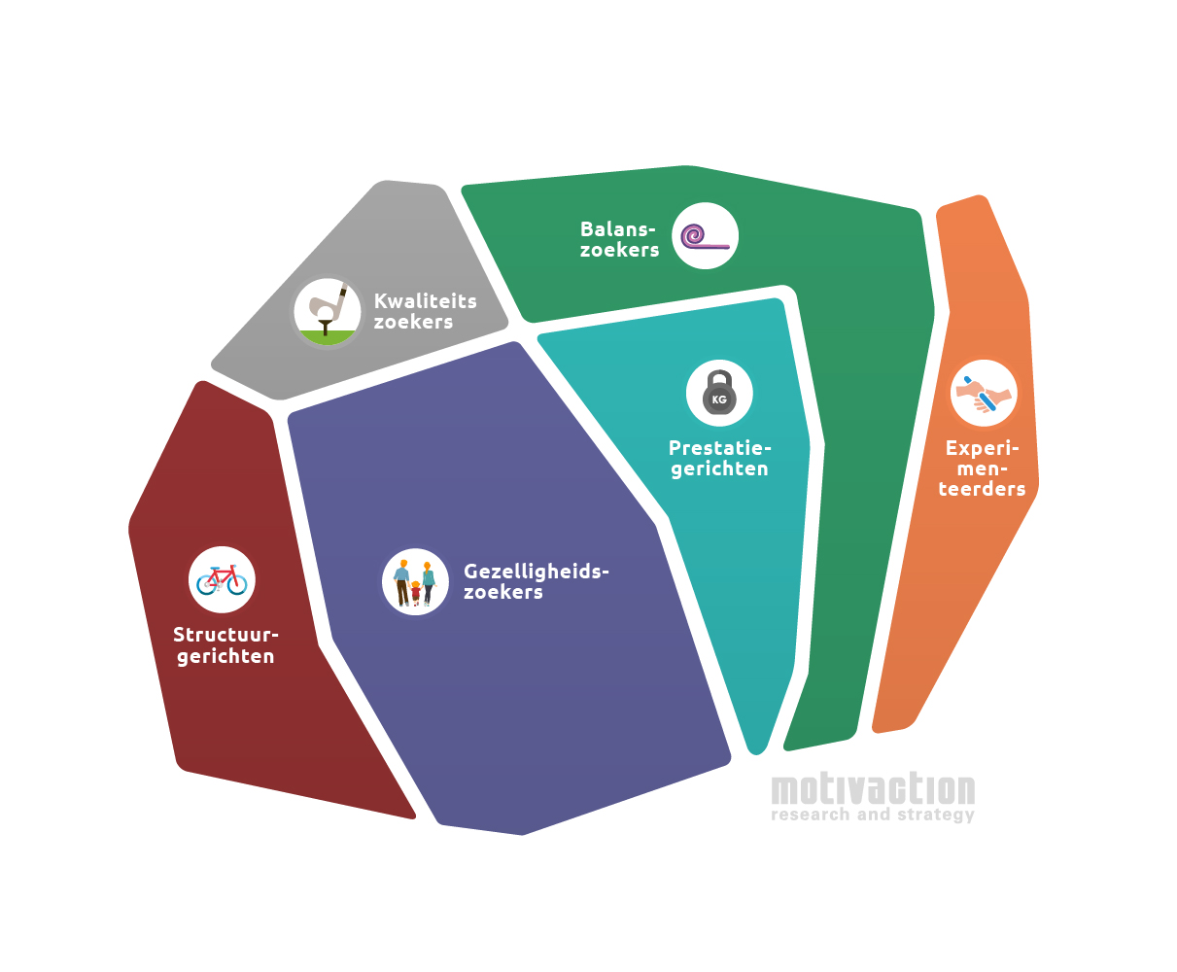
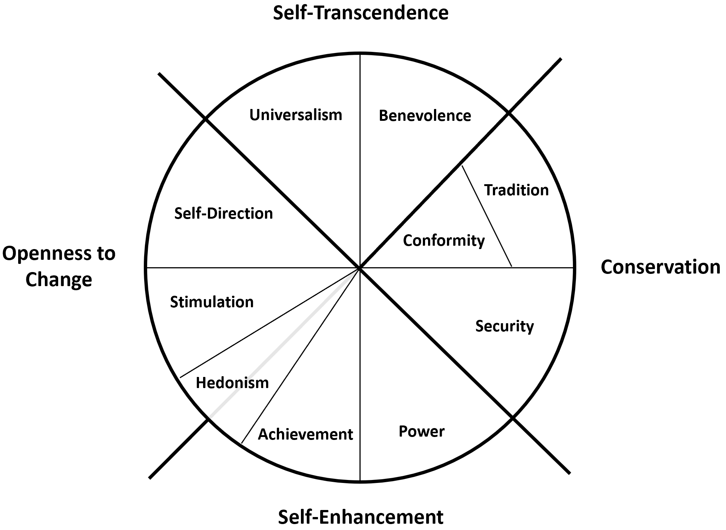
Values and Value Systems (I)
Schwarz’ (1992) Value Circle
Motivaction: Mentality Model
Schwartz, S. H. (1992). Universals in the content and structure of values: Theoretical advances and
empirical tests in 20 countries. In Advances in experimental social psychology (Vol. 25, pp. 1-65). Academic Press.
Notes:
Image credit schwarz https://miro.medium.com/max/3918/1*9YQtNV0WVCR_fwUI-_QoCg.png Image credit motivaction: http://motivaction.nl/images/basismodel%20mentality.png

Slide 14
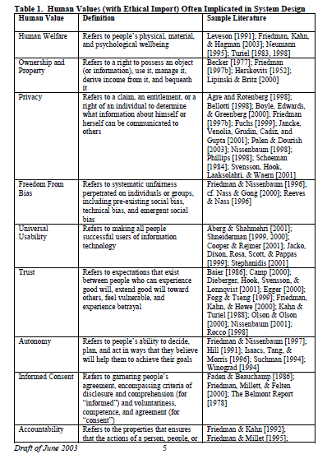
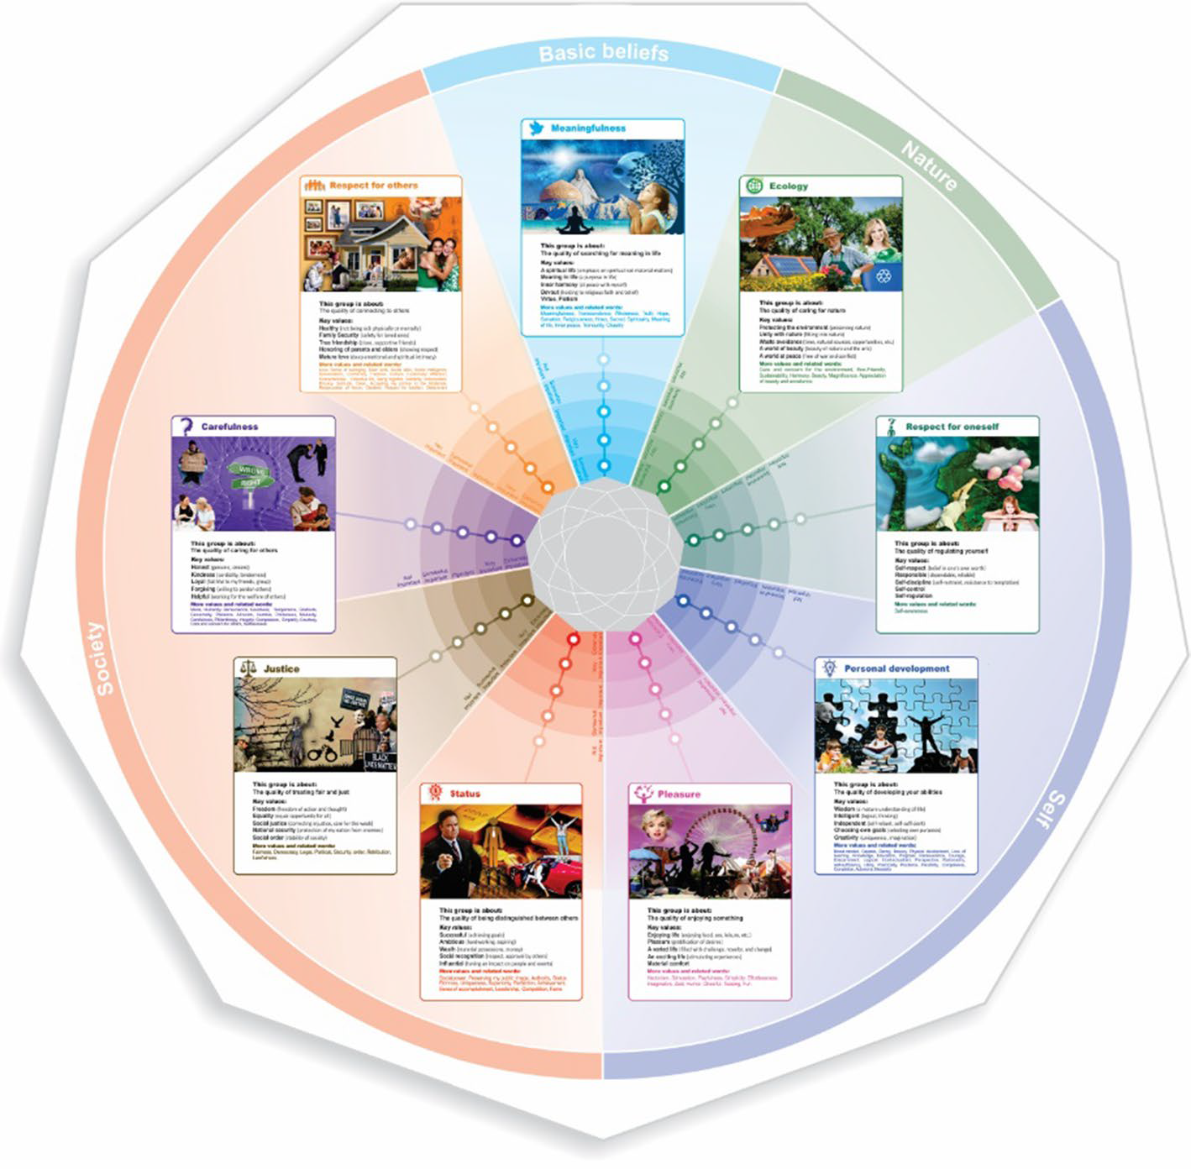
Values and Value Systems (I)
Friedman Value Ignition List
Kheirandish: HU Value Tool
Kheirandish, S., Funk, M., Wensveen, S., Verkerk, M., & Rauterberg, M. (2019). HuValue: a tool to support design students
in considering human values in their design. International Journal of Technology and Design Education, 1-27.
Notes:
Image credit from paper Kheirandish

Slide 15

Stakeholders: Who is affected
Direct / Indirect.
Human / Non-Human
Spotify (9….A lot)
Customers
Friends of customers
Artists
Advertisers
Music Industry
Bars and theatres etc.
Spotify (employees)
Radio and TV stations (and other competitors)
Knowledge economy
Notes:
Image credit https://images.complex.com/complex/images/c_fill,f_auto,g_center,w_1200/fl_lossy,pg_1/cuiicx2dezkjzlp49oj9/spotify-playlists-getty-mahmut-serdar-alakus

Slide 16
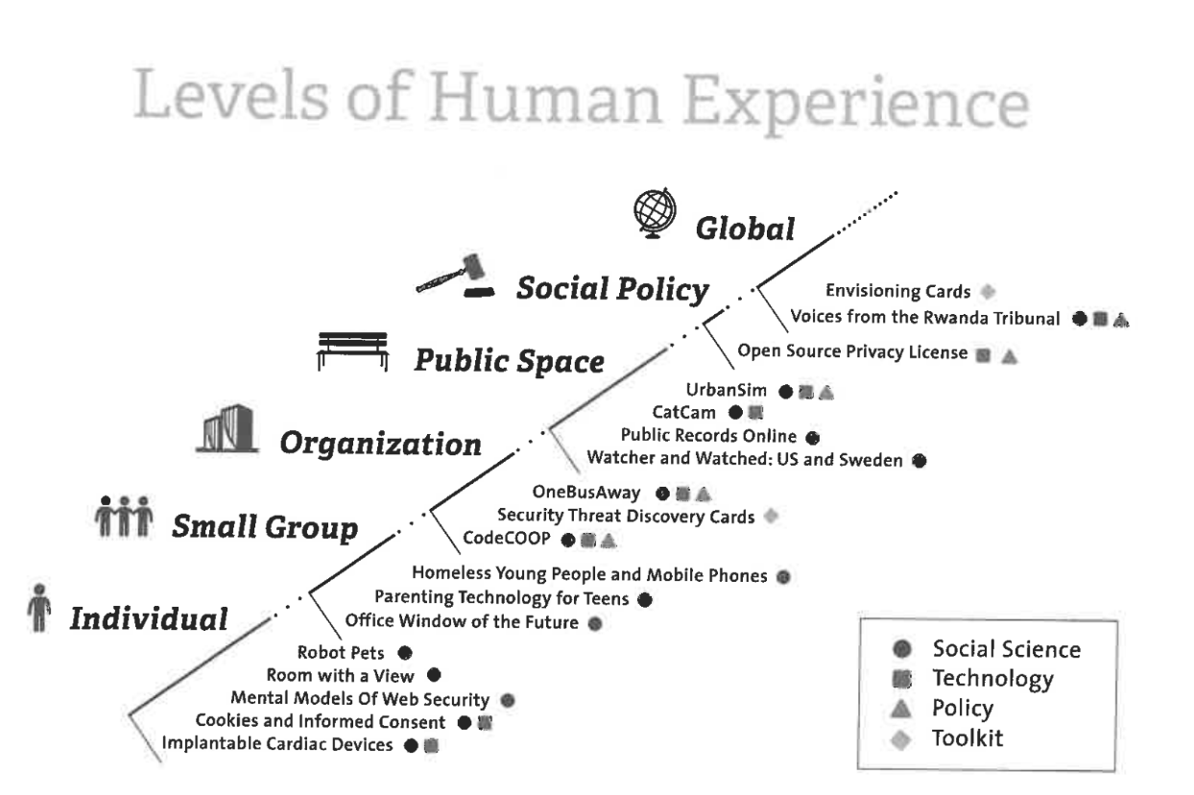
Levels of experience
Notes:
Image credit: https://miro.medium.com/max/2488/0*HIIYpDzdGzHFh9Xl

Slide 17
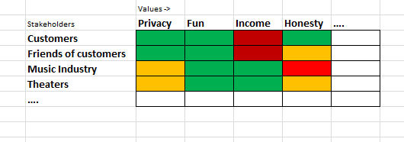
Mapping Values to Stakeholders

Slide 18
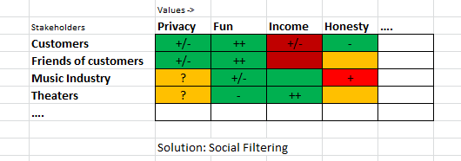
Mapping Design Alternatives to Values and Stakeholders

Slide 19
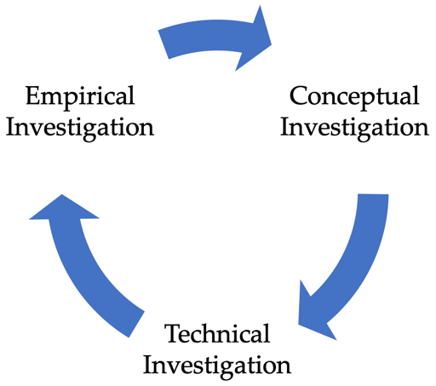
Tripart Methodology
Conceptual Investigations
Considering values and value priorities
Relating values and value conflicts to the design
Empirical Investigations
Investigating (value priorities) in the context of use.
Investigating the (moral) effects of technologies.
Technical Investigations
Investigate how technologies can support or hinder human values.
Investigate how technologies can be designed to safeguard particular values.
Notes:
Image credit https://www.researchgate.net/profile/Steven_Umbrello/publication/342261933/figure/fig2/AS:903723467407361@1592475873521/The-tripartite-iterative-Value-Sensitive-Design-methodology.ppm

Slide 20
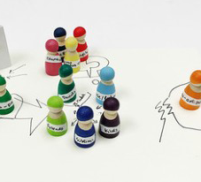
METHODS: Stakeholder MAP
Visualises all stakeholders
Categorises stakeholders into groups (if needed)
Lists key characteristics of stakeholders
Stakeholder tokens can be used to map out different scenario’s
Stakeholder MAP
Notes:
Image credit https://media.springernature.com/lw685/springer-static/image/art%3A10.1007%2Fs10676-018-9474-4/MediaObjects/10676_2018_9474_Fig3_HTML.jpg

Slide 21

METHODS: VaLUE Centred Interviews
Interview stakeholders about their needs
Try to elaborate on underlying values
Ask to evaluate existing technologies in ‘moral’ terms
Notes:
Image credit https://www.topechelon.com/wp-content/uploads/2018/12/Value-based-interview-questions-RS13882-compressor.jpg

Slide 22
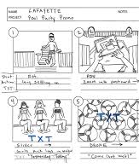
Value Sensitive Scenario’s
Sketches how alternative scenario’s will affect stakeholders.
Highlight: (1) implications for stakeholders, (2) key values, (3) widespread use, (4) indirect impacts, (5) long-term use, (6) systemic effects.
Use storyboarding or narrative scenario’s
Notes:
Image credit https://blogbertos.com/wp-content/uploads/2018/09/Lafayette-Pool-Promo-Storyboard-v1.jpg

Slide 23
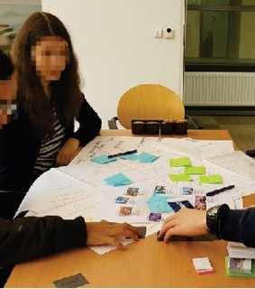
Value Envisioning Cards
Cardsets help to designers to reason about values and stakeholders to reflect on values in design.
HU Value Tool (Kheirandish)
Envisioning Card Toolkit (Friedman et al.) www.envisioningcards.com
Notes:
Image credit https://i.ytimg.com/vi/6HPgN050DIw/maxresdefault.jpg

Slide 24
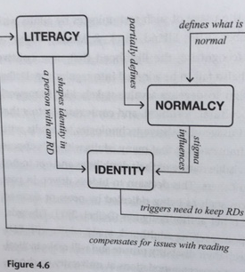
Value interactions
Values incorporated in solutions, may interact in predictable way’s.
Mapping out these interactions provide insights in how your solution affects certain values of certain stakeholders.
Notes:
Image credit photo taken from the book Value Sensitive Design (Friedman)

Slide 25
25
Today:
1 A short history of Human-Cented Design
2 Value-sensitive Design Approaches
3 Values in data-driven systems

Slide 26
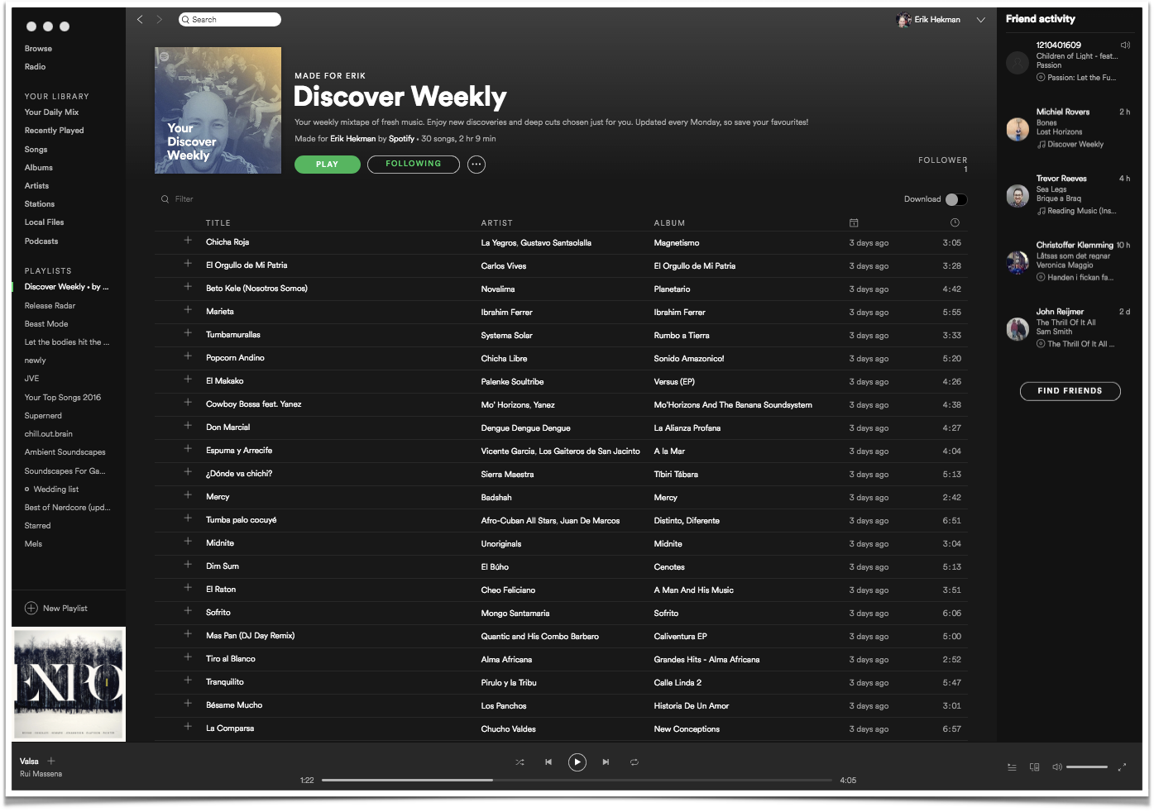
26

Slide 27
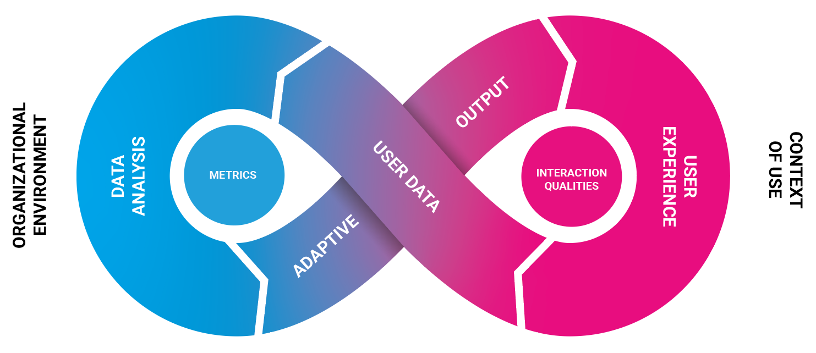
27
Data-Driven Feedback Loop (Smits et al. 2020)
Smits, A., Van Turnhout, K., Hekman, E., & Nguyen, D. (2020). Data-driven design. In DS 104: Proceedings of the 22nd International Conference on Engineering and Product Design Education (E&PDE 2020).

Slide 28
28

Slide 29
29
Discover Weekly
Organizational environment: unlimited offer of music & podcasts
Context of use: a customer, in his car, wants to listen to music fitting for his taste
and the moment

Slide 30
30
Discover Weekly
User data: listening behavior over time
Data analysis: profiling music ‘taste’

Slide 31
31
Discover Weekly
Adaptive output: discover weekly list (with selected music, according to taste)
User experience: interesting music

Slide 32
32
Discover Weekly
Metrics: focus of the data analysis (what do you need to know)
User similarity
Interaction qualities: focus of the UX (what user value do you optimize)
Personally relevant

Slide 33
33
Personalised News
Newspaper
User Data:
Clicked links (or not)
Data Analysis:
User profiling
Metrics:
Delay prediction
Interest prediction
News user
Adaptive output:
Suggested articles
User experience:
Liking the article
Interaction Quality:
Relevant content

Slide 34
34
Adaptive games
Game company
User Data:
User playing behavior
Data Analysis:
Comparison with user history and use paths
Metrics:
Difficulty
Player
Adaptive output:
New challenges
User experience:
Game world
Interaction Quality:
Engagement

Slide 35
35
Failing systems:
Typically: derailed optimization
a mismatch between interaction qualities and metrics.
simple metrics for complex qualities
Example: click bait: metric is click-rate, but quality is interestingness
Multiple qualities might to be needed
Often context sensitivity is lacking
designed for average users
designed for average use-cases

Slide 36
36
Interaction Qualities (Aestetics, Values in use)
Engagement: does this application draw me in?
Loyalty: do I want to return to this service?
Seamlessness: does this interaction go smoothly?
Relevance: does this interaction fit my current needs?
Personalized: does this feel as ‘especially for me’?
…..

Slide 37
37
Outeraction Qualities (Utility, values of use)
Efficiency: does this application help me get my work done?
Entertainment: does this application provide me with a fun time.
Information: does the applciation help me get informed about important events?
Etc.

Slide 38
38
Reccomender systems
Values in use (interaction qualities) and of use are often related.
Value of using spotify is universal acces of music, value in use efficient music discovery
Value of using navigations app is quick wayfinding, so the value in use needs to be seamlessnes
Etc…

Slide 39
Contact
Dr. Koen van Turnhout Research Group Human Experience & Media Design (HEMD)
University of Applied Sciences Utrecht P.O. Box 85029, 3508 AA Utrecht, The Netherlands
Koen.vanturnhout@hu.nl
https://www.linkedin.com/in/koenvanturnhout/
https://bit.ly/DataDrivenUXDesign

